Slide 1
MOVIE BOOKING SYTEM APPLICATION
A Project Developed by
Ashwin Vivilian J - 43111267

Slide 2
Abstract
This project is a React-based Movie Booking Application that allows users to browse movies, view details, and book tickets online. The system provides an interactive and responsive interface developed using React components.

Slide 3
Objective
- To design a user-friendly web interface for movie ticket booking.
- To apply React concepts like components, props, and hooks.
- To simulate the booking process using React state.
- To enhance UI interactivity and responsiveness.

Slide 4
Existing System
- Movie booking done through manual counters or complex apps.
- Lack of responsive and interactive web pages.
- Limited customization for smaller theatre systems or demos.

Slide 5
Proposed System
- Web app with modern UI built using React JS.
- Allows users to select movies, choose seats, and confirm bookings.
- Uses state management to track user input dynamically.
- Entirely front-end based — no backend required.

Slide 6
Technologies Used
Framework: React JS
Languages: HTML, CSS, JavaScript
Tools: Visual Studio Code
Version Control: GitHub

Slide 7
System Architecture
User (Browser)
↓
React App (Components + Hooks + State)
↓
Local Storage / Temporary State
React components handle the entire booking flow — from displaying movies to confirming tickets.

Slide 8
Major Components
1. App.js – Root component handling routes.
2. MovieList.js – Displays all available movies.
3. MovieDetails.js – Shows movie info and booking option.
4.MovieCard.js- Shows movie posters

Slide 9
Working Procedure
1. User opens the movie booking website.
2. React displays movie cards using component rendering.
3. On selecting a movie → opens booking form.
4. User selects showtime, date, and seats.
5. Confirmation page shows the booked details.

Slide 10
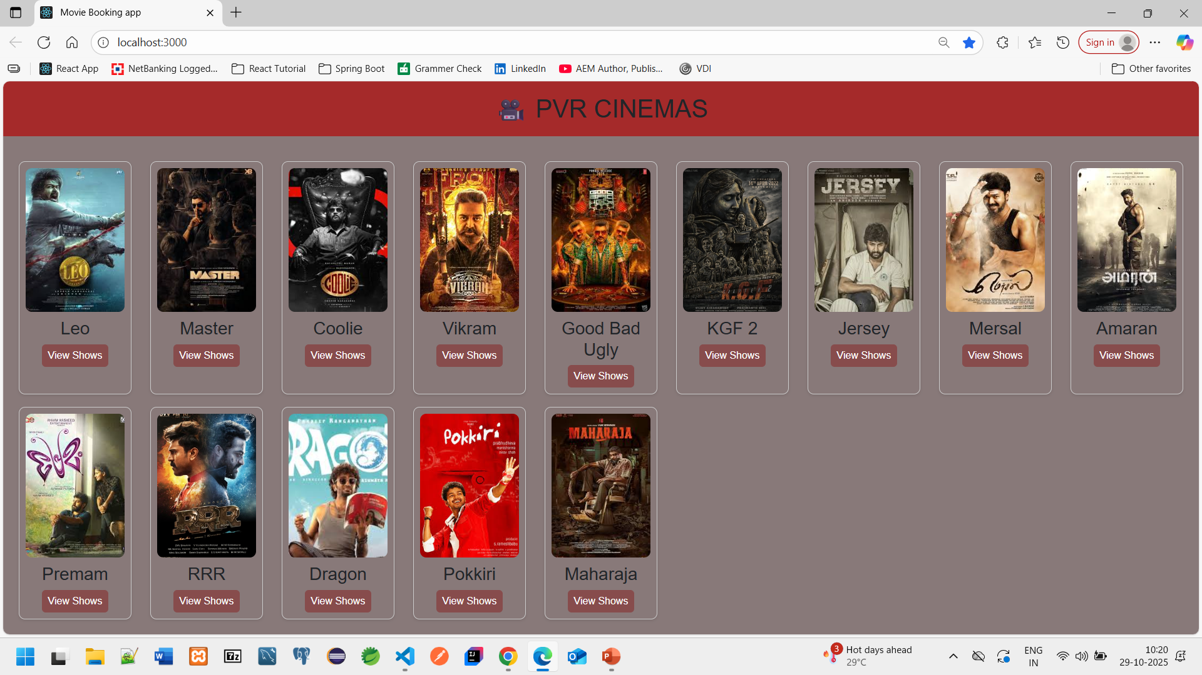
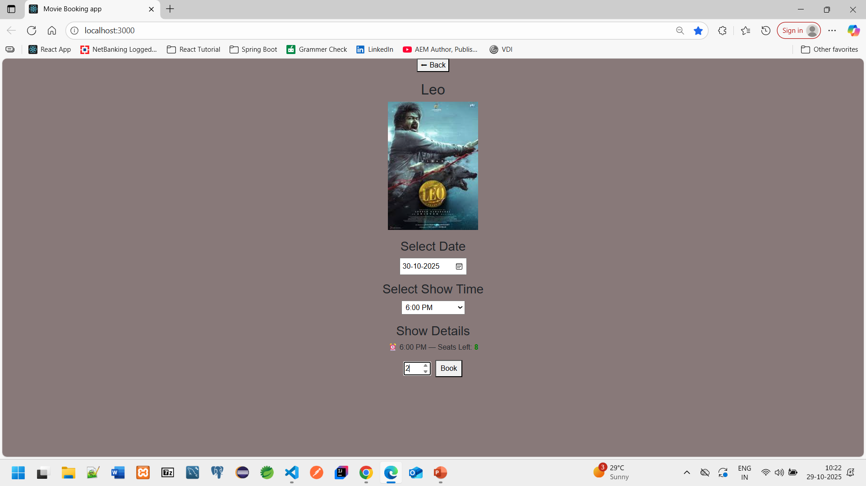
Screenshots

Slide 11
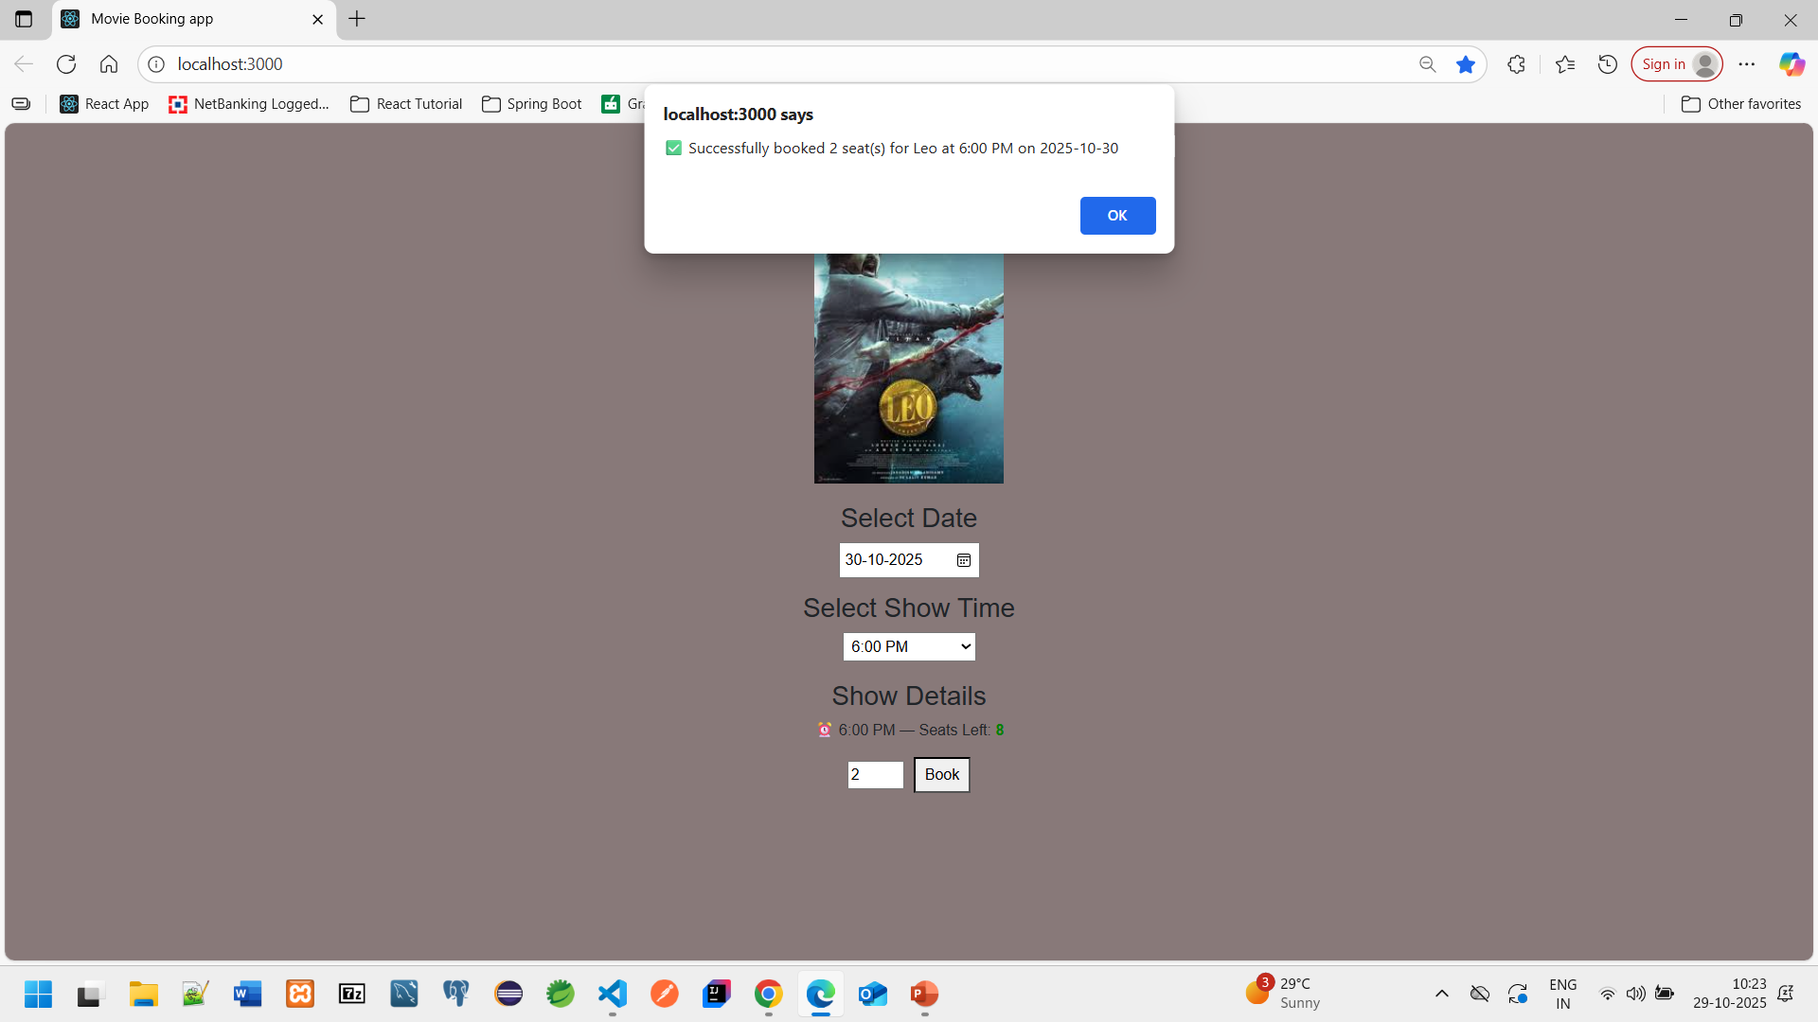
Screenshots

Slide 12
Result and Discussion
- Successfully built a fully functional frontend web app using React.
- All user actions handled via state and props.
- Responsive UI that works across devices.
- Demonstrates component-based design and React routing.

Slide 13
Conclusion
The Movie Booking System demonstrates how React JS can be used to design a complete, interactive frontend web application. It simplifies user interaction, improves design efficiency, and enhances the booking experience without needing a backend.

Slide 14
Future Enhancements
- Add Node.js backend and MySQL integration.
- Implement authentication (login/register).
- Add seat map and payment gateway.
- Deploy on GitHub Pages.

Slide 15
References
- React Official Docs: https://react.dev
- MDN Web Docs: https://developer.mozilla.org/
- W3Schools React Tutorial: https://www.w3schools.com/react/

